Slide 1
Making a Game AI
With Reinforcement Learning
Danny Bullis & Nicholas Fang
Notes:
Nick
Im nick and this is my project with Danny
For this project, we will be talking about

Slide 2
Agenda
Intro: Making a game AI
About the game
Naive approach: Linear Regression
Pivot: Reinforcement Learning
Implementation
Results
Notes:
Nick
A roadmap about or project:
We will tell you about our inspiration for pursing this project
We will then tell you a little about the game designed
Well will talk a little bit about our initial approach
Why we decided to do a quick pivot and the implementation of a RL model
And finally, the findings of our little experiment

Slide 3
Intro: Making a game AI
Notes:
Nick

Slide 4
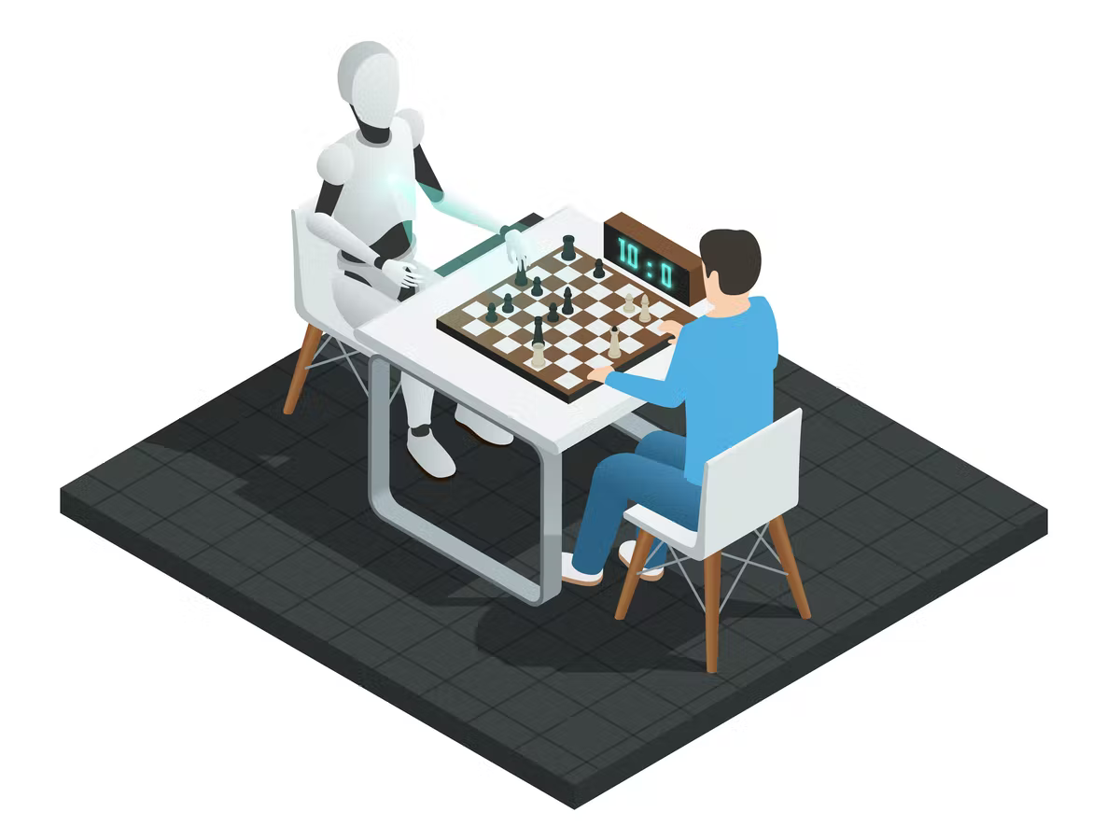
Our goals & objectives
Our Goal:
Create a game AI to move around a Board and collect Loot…with minimal human programming!
Objectives:
Explore data science in a gaming application.
Research ML techniques and select tools.
Develop and train a responsive game AI.
Show meaningful results.
Have fun!
(Lavanchy & Joshi, 2019)
Notes:
Nick
A little bit about our research question and goal, we wanted to
Some objectives that we wanted to hit were to

Slide 5
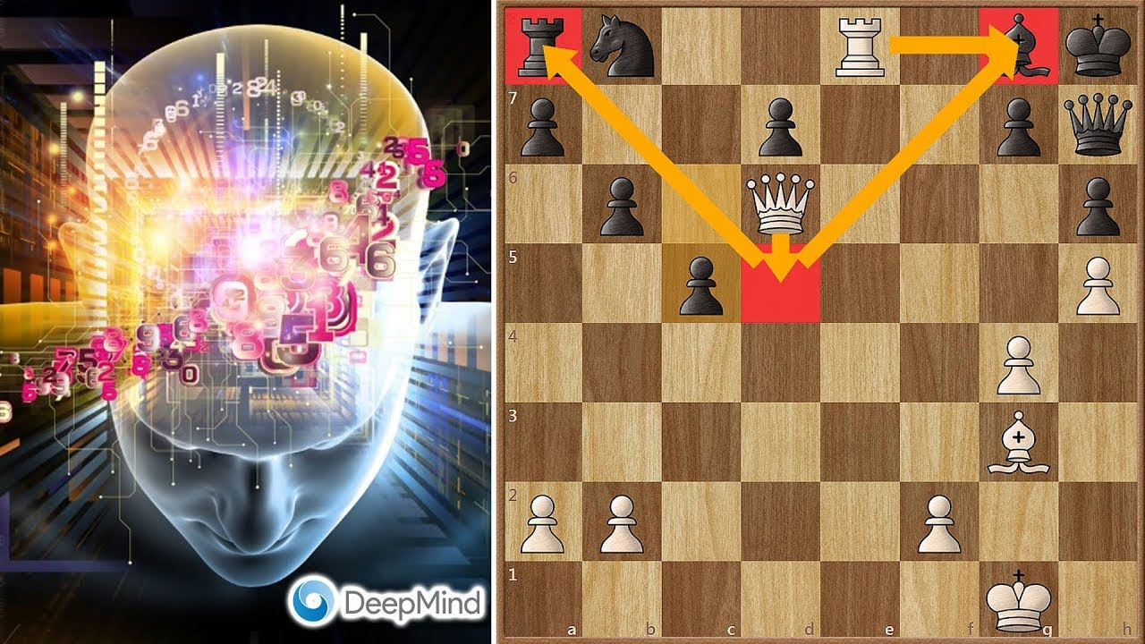
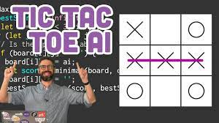
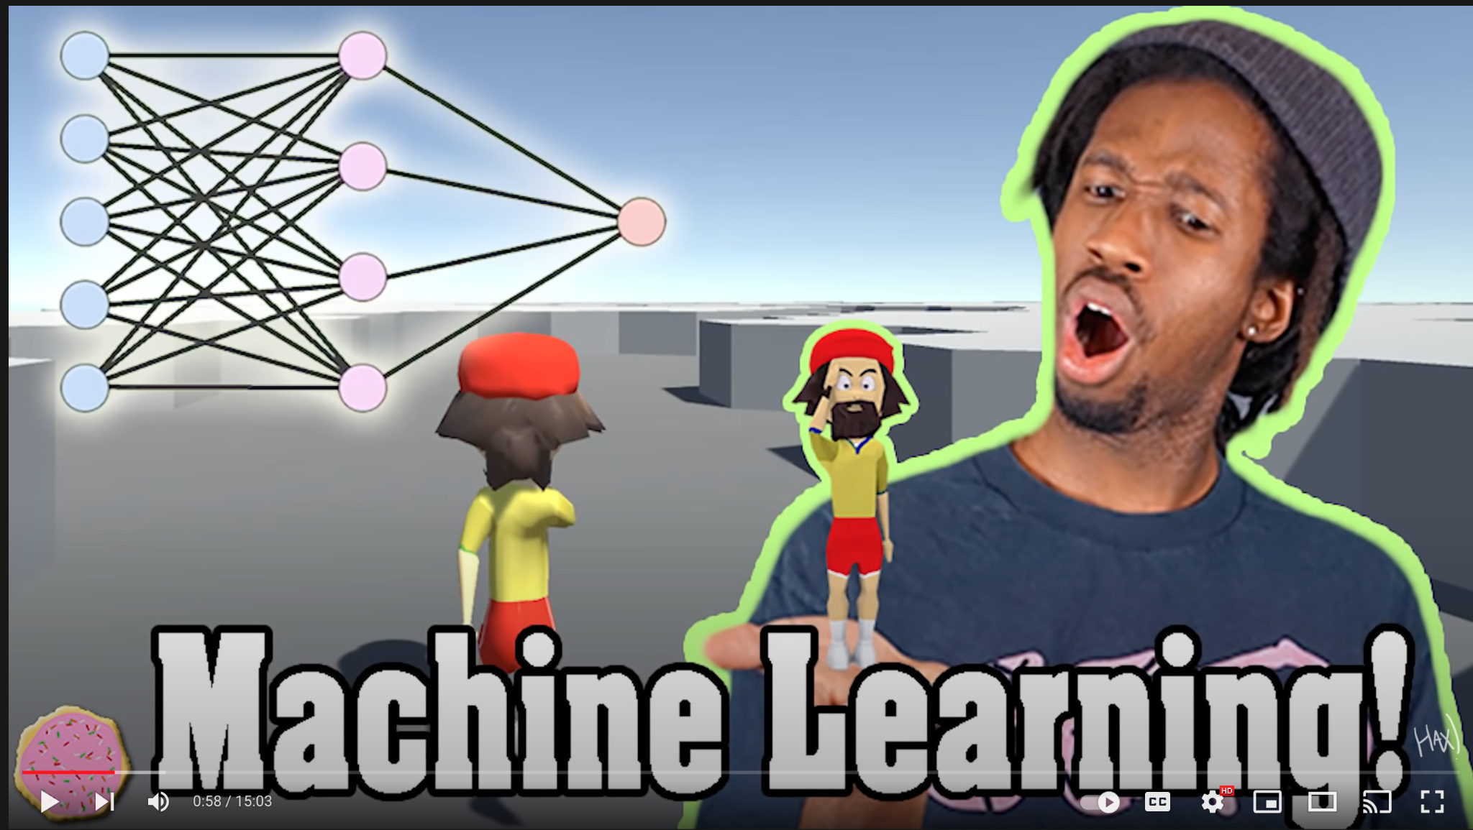
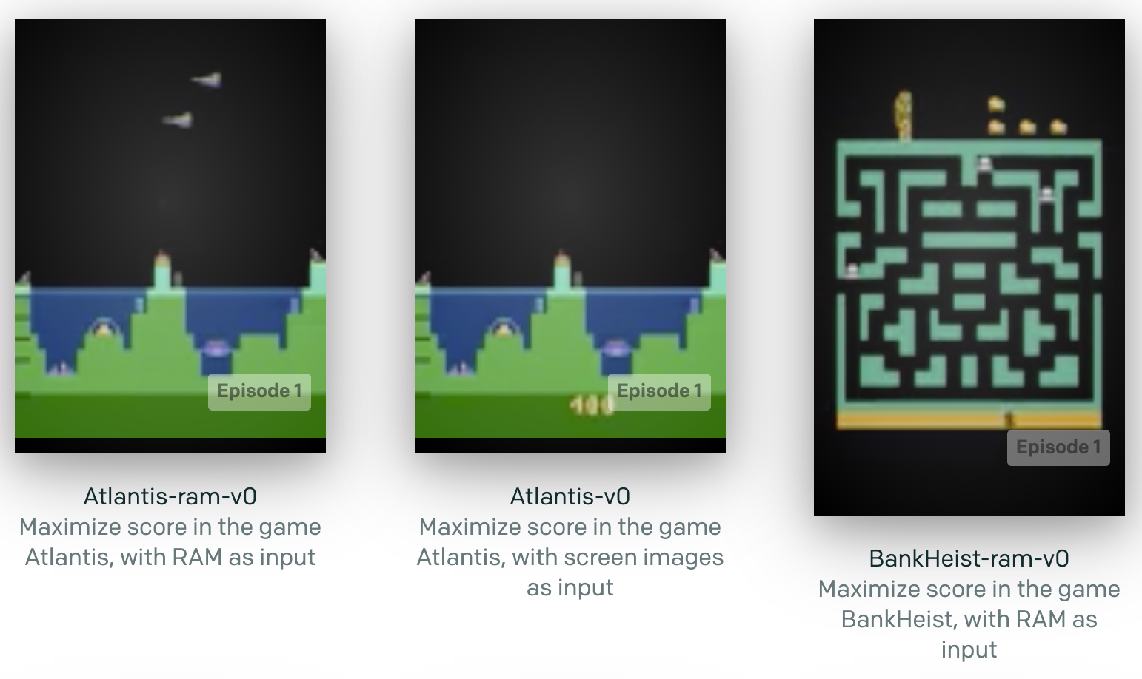
Exploring data science in gaming applications
Inspiration:
AlphaZero (Google DeepMind)
Jabrils (YouTube)
The Coding Train (YouTube)
OpenAI Gym
AlphaZero (Agadmator, YouTube)
The Coding Train (Coding Train, YouTube)
Jabrils (Jabrils, YouTube)
OpenAI Gym (openai.com)
Notes:
Danny

Slide 6



Researching ML techniques and select tools
Tool selection and resources:
Google Colab Pro: cloud notebook for running python with GPU capabilities.
PyTorch: a rich python library full of ML models, functions, tutorials and documentation.
OpenAI: a leading AI research company that publishes open source ML tools and game AI training resources.
Research: towardsdatascience.com, medium.com, StackOverflow.com, etc.
We’ll revisit this later!
Notes:
Danny

Slide 7

Developing a responsive game AI
How do we go about this?
What should the mechanics of our game be?
Um…We’ve never done this before.
This is the “crux” of our project.
Simple approach with Linear Regression?
Bite the bullet and use Reinforcement Learning?
Notes:
Nicholas
The first step was to design the game that we wanted to implement with a game AI. There were many iterations of designing the game and much more complex functions planned but to make it a feasible project given the time frame, we had to strip it down to the most basic version and start with small steps.
So with designing and developing a responsive game AI, some questions and concerns that we encountered we
Defining the mechanics of our game
Designing a game AI, This was a new topic for both of us
We first wanted to explore training a game agent using LR, we will talk about why that didnt work in a bit
And then we will discuss why we decided to research and implement RL

Slide 8
Measuring Success
Strategy:
Build a game with super simple mechanics.
Establish a Baseline: Track loot captured using a random movement strategy.
Implement an ML model to predict the best possible move.
Track loot captured using a trained ML model.
Convince (reasonably) that the ML model trends towards more loot captured.
Notes:
Nick

Slide 9
About the game
Notes:
Nick

Slide 10
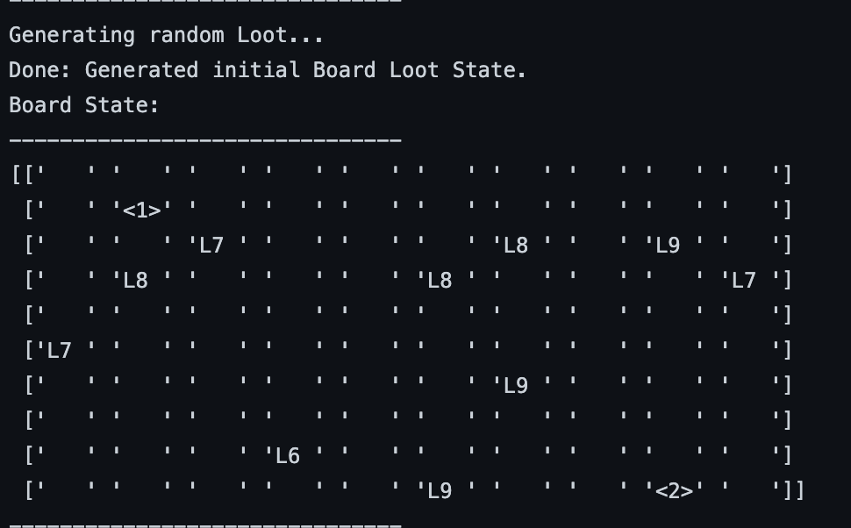
Game Mechanics
Version 0:
Board: a 10 x 10 grid (Environment).
Move: 1 grid square per turn (Action).
Player 1: our AI player (Agent).
Collect: pick up loot from an adjacent square (auto).
Game: maximum of 100 turns or end when no loot left.
v.next:
Player 2: a player moving randomly. Too complicated for now!
Combat: attack another player to collect their loot. Too complicated for now!
Terrain: navigate around terrain. Too complicated for now!
Evac: safely remove player from board to stow loot. Too complicated for now!
Figure 1: An early rendition.
Notes:
Nick
The first step was to design the game that we wanted to implement with a game AI. There were many iterations of designing the game and much more complex functions planned but to make it a feasible project given the time frame, we had to strip it down to the most basic version and start with small steps.
The games and rules that were settled upon are:
1 agent (computer)
Set loot initiated on a game board
Agent moves 1 block or loots during its turn
Game (Episode) ends after 100 steps
Agent to be trained on that data after each episode

Slide 11
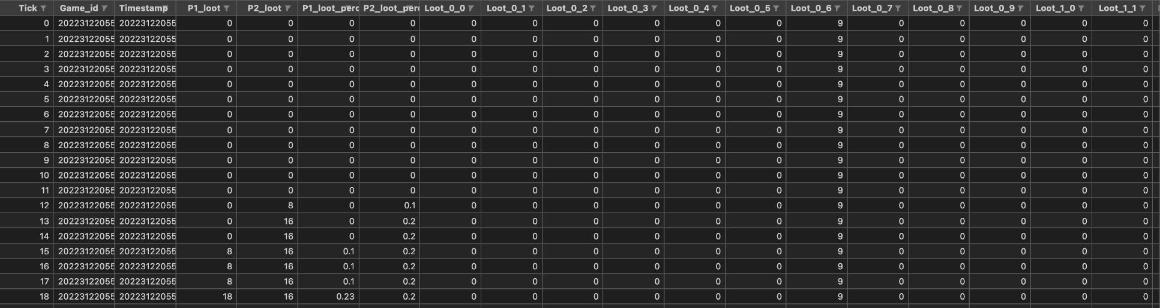
Naive: Initial Setup
Game State Data:
Board data stored in a 1D vector.
Store loot and player positions, and player score.
Each “tick” of the game as a separate observation.
Use Linear Regression on this structure.
Predict winner, given any single state.
Notes:
Nick: Our initial approach was to build a custom game engine and to then generate data points from simulating games played.
The resulting game state data would then be used to train a game agent on how to optimally collect loot.
As shown above, we
Configured (X, Y) coordinate system. As a 1D vector
Squares given a value if player or loot occupied that space.
Each row represents successive sequential actions within the game.
We first attempted to use LR on the generated data to predict the winner given any game state

Slide 12
Naive approach: Linear Regression
Notes:
Danny

Slide 13
Naive: Training the Model
Strategy:
Run a bunch of simulations (1,000+) to generate a bunch of logs.
Train a simple classifier model using those logs to predict winner.
Rerun games using model.
Simulate predicted winner for all possible actions (continuous number).
Pick the best action (greedy).
Problems:
Very slow!
Lots of data (games).
Very manual.
Requires game logic code.
RL automates this…way better!
simulations
training
replay
Game State
(simulation 1)
Game State
With LR
(simulation 1)
Game State
(...)
Linear Regression
Predict: winner
Game State
With LR
(...)
Game State
(simulation N)
Game State
With LR
(simulation N)
iterate
Notes:
Danny

Slide 14
Pivot: Reinforcement Learning
Notes:
Danny

Slide 15
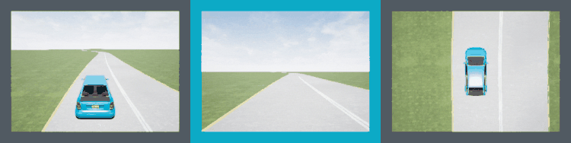
What Is Reinforcement Learning?
What is reinforcement learning?
One of the 3 basic ML paradigms. Reinforcement learning is the area of ML concerned with how intelligent agents ought to take actions in an environment, in order to maximize the notion of cumulative reward.
Examples of applications that use reinforcement learning:
Self driving cars
Dynamic pathing
Natural Language Processing
Text summarization and machine translation
Robotics
Learning movements and correct behavior
Reinforcement learning in gaming?
Prime example of RI in gaming is AlphaGo. Using RI, AlphaGo was able to teach itself how to play Go by playing against itself. After 40 days of training, AlphaGo was able to beat some of the strongest Go players in the world.
Amazon Deep Racer
Notes:
Danny
Reinforcement learning is useful in any context which requires an agent to be trained in a fashion that utilizes rewards and punishments. The agent is rewarded for correct behavior and punished for wrong ones. In doing so, the agent tries to minimize the wrong moves and maximizes the right moves

Slide 16
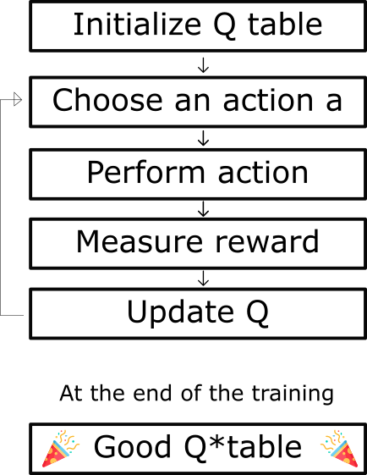
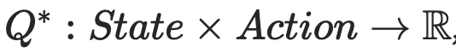
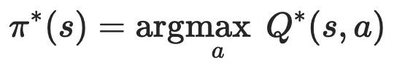
Chosen RL Model
Deep Q Learning
What is Deep Q Learning?
Q- learning learns an action value function Q(s,a). This function examines how to take an action at a particular state by assigning a scalar value over an action a given the state s.
Notes:
Danny

Slide 17
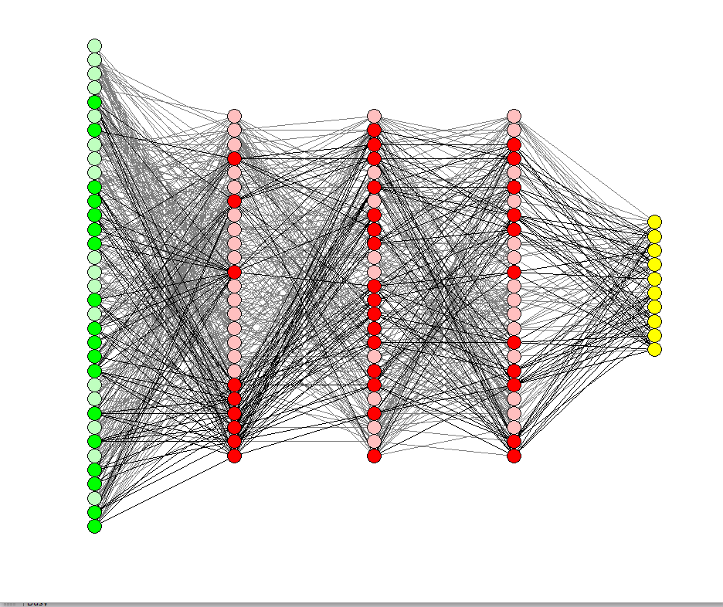
Convolutional Neural Network (CNN) and Deep-Q Learning
Benefits of CNN:
Think image recognition. We treat states as images and use convolutions to look for patterns that yield high rewards.
Output
Input
Step Function:
Use the Q function to find the action that returns the maximum reward (exploitation).
Choosing an action based on epsilon decay:
Every so often, the network introduces randomness using epsilon. This action deviates from the greedy method (highest q-value) to allow the model to “explore” the landscape.
The neural network approximates Q-values for each action based on the state, mapping inputs to Q-value) pairs.
Notes:
Nick
A little more about this process and the method chosen for reinforcement learning.
our input (game board) and outputs (NW, …, SE)
There are lots of possible layers!
Different performance, different results, different applications, etc.
Memory
All of the observed transitions (state, action, reward) that occur within each episode (game) played during training.
Screenshot of game memory.

Slide 18
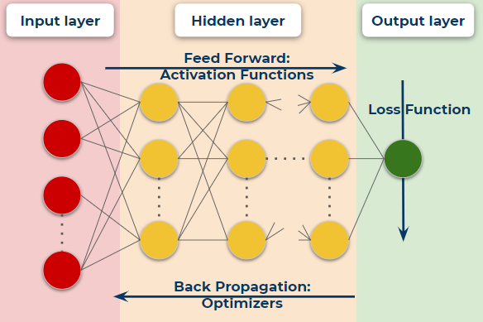
Loss Function, Optimization, Back Propagation
Loss Function:
In learning networks, the loss is calculated as the difference between actual and predicted output. The function used to compute this is known as a loss function (J).
Back Propagation and Optimization:
For accurate predictions, we are trying to minimize loss. In neural networks, this is done via back propagation. Optimized gradients are back-propagated through the network, where it is used to modify weights and biases to reduce loss on future predictions.
Figure 1: Weights modified using an optimization function, where it calculates a gradient.
Notes:
Nick
the components of a neural network model i.e the activation function, loss function and optimization algorithm play an important role in training a Model and producing accurate results.
Long story short, this will help the model update the weights and biases. This cycle eventually helps the model choose optimal outputs, resulting in better predictions.

Slide 19
Implementation
Notes:
Nick

Slide 20
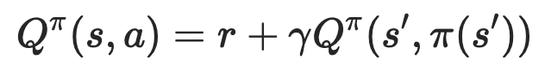
RL Reward Design
We want to maximize Q(state, action)...the reward gain of our action…by predicting which action to take that gives us the highest reward.
Goal:
Maximize this
reward
predicted action
Training rule {
(Paszke, 2021)
Reward += 10 for collecting one loot.
Reward += 100 for collecting all loot in a game (aka “solving”).
Penalty -= 0.1 for each step taken not resulting in loot.
Notes:
Nick
As indicated by this function
A little about the reward and penalty system implemented
for each action selected by the agent the environment provides a reward if the agent chooses a successful action, a +10 for our game
A penalty of -0.1 is given for actions not desired, in our game, a penalty for a step taken that does not result in loot.
An overall score of 100 is possible for collecting all the loot within a game.
Expected state actions, the expected output, what the network expects to get out of this prediction
We gets

Slide 21
RL Model Design
Conv2D
Process input data with convolutions.
BatchNorm2D
Normalize values from [0, 1] for stability and speed.
Linear
Fully-connected layer.
8 outputs for each possible action.
NOTE: these parameters were not tuned thoroughly.
Initial design (unoptimized):
DQN(
(conv1): Conv2d(3, 16, kernel_size=(10, 10), stride=(4, 4))
(bn1): BatchNorm2d(16, eps=1e-05, momentum=0.1, affine=True, track_running_stats=True)
(conv2): Conv2d(16, 32, kernel_size=(10, 10), stride=(4, 4))
(bn2): BatchNorm2d(32, eps=1e-05, momentum=0.1, affine=True, track_running_stats=True)
(conv3): Conv2d(32, 32, kernel_size=(10, 10), stride=(4, 4))
(bn3): BatchNorm2d(32, eps=1e-05, momentum=0.1, affine=True, track_running_stats=True)
(head): Linear(in_features=512, out_features=8, bias=True)
)
(Paszke, 2021)
Notes:
Nick
To give a quick summary of this visualization, these are the layers the layers that we implemented within our model
Convolutional layer - normalization layer
To linear layer, where it Connects hidden layers to the 8 output nodes

Slide 22
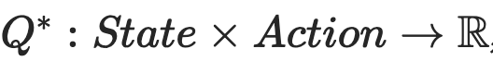
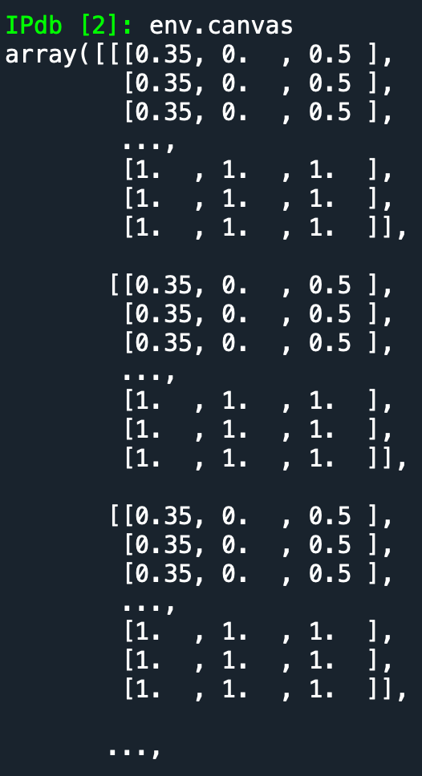
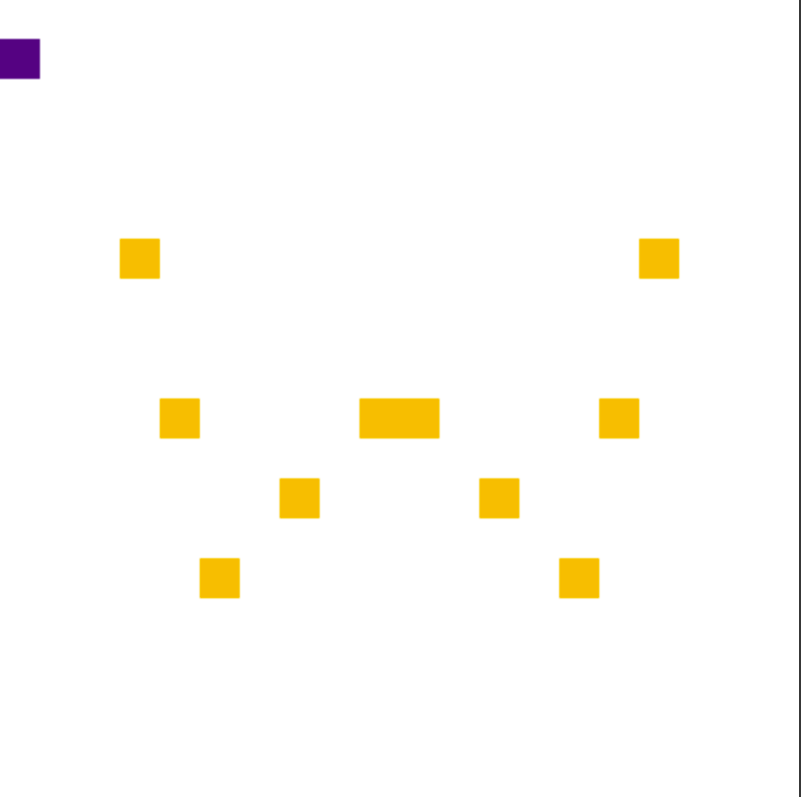
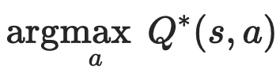
RL Model Design (Abstract)
(possible actions)
NW | N | NE
W |  | E
SW | S | SE
(Paszke, 2021)
Feed forward
Outputs
NW
N
NE
W
E
SW
S
SE
Input (RGB tensor):
Rendered image in custom OpenAI gym environment:
Convolutions
Convolutions
Normalize
Normalize
…
Best action
(highest reward)
weights & biases…
Back propagation
optimizer
loss
Notes:
Danny

Slide 23
Pseudocode
(Paszke, 2021)
env = Board() # custom OpenAI environment
policy_net = DQN(env.screen) # update separately for stability (temporary)
target_net = DQN(env.screen) # update infrequently for stability (we’ll keep this)
# main loop
episodes = 50 # number of games to play
maxsteps = 100 # max number of steps per episode (game) for episode in range(episodes):
env.reset() for step in range(maxsteps):
state, action, reward = step(policy_net, possible_action) # pick an action, calculate reward
loss = SGD(prev_states - predicted_states) # calculate the loss (batch of states)
optimizer.update_gradients(loss) # calculate new gradients based on loss
optimizer.backward() # back propagation, modify hyper parameters
policy_net.update_params() # apply hyper parameters changes
target_net.update(policy_net) # use the volatile policy_net to update our stable target_net
NOTE: for reasoning behind using two networks (policy, target), see (Torres, 2020)
Notes:
Danny

Slide 24
RL: advanced concepts
Parameter - Epsilon (greedy) decay: every so often take a random move instead of the best (exploration).
Parameter - Gamma: “discounts” rewards that are more distant (uncertain) to favor those in the immediate future.
PyTorch - Model: base class which we implemented using code we adapted from tutorial site.
PyTorch - Optimizer: used Adam algorithm for this implementation because of its speed.
PyTorch - Loss: used Huber Loss algorithm (MSE for small errors, MAE for large to reduce impact of outliers), but regular stochastic gradient descent would do!
Notes:
Danny

Slide 25
Results
Notes:
Nick
Now we will discuss some of the results from our experiment

Slide 26
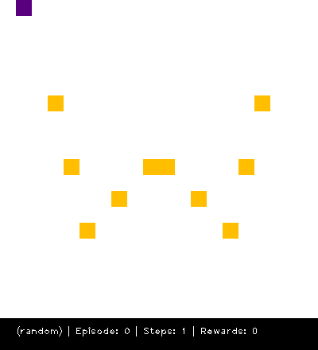
Initial run: Random Movement
The first step was to initialize an agent to take random movement.
As per the visualization, loot is placed in predetermined positions on a static board. The agent will wander about trying to collect the loot (yellow squares). The number of steps taken, the amount of loot collected, and each successive game is recorded.
Remember: The goal of this step is to establish a baseline from which we can show improvement when running our RL model.
Notes:
Nick

Slide 27
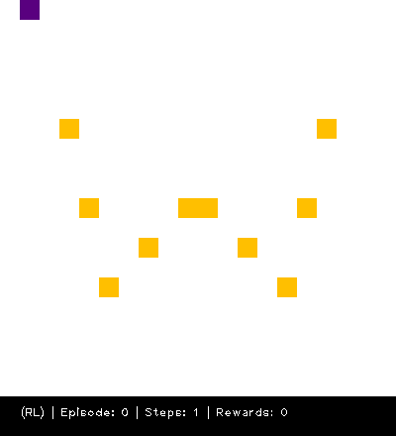
Second run: RL Movement
Next, we re-ran the experiment using our RL implementation.
This took a bit longer because of the time the model needs to iterate over hundreds/thousands of nodes during optimization and back propagation.
Ideally, we would run operations with a GPU to train over many more games (300+); we trained on 100.
Remember: Our goal is to show better-than-random performance!
Notes:
Nick
In the second iteration, we wanted to test implementing RL with training our game agent
Training x games took about x minutes

Slide 28
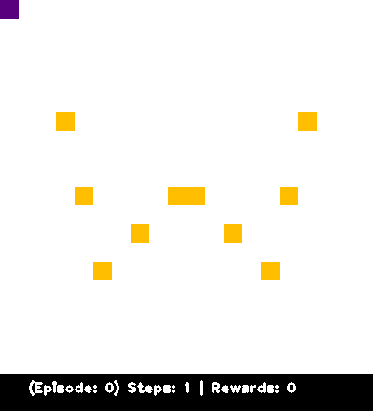
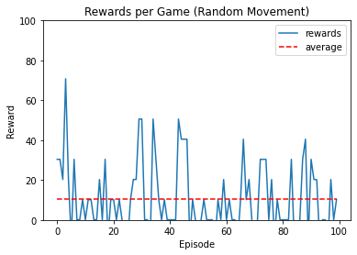
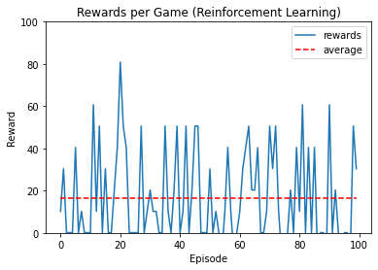
Results: Random vs RL movement
Random movement
On average, collected about 10 reward per episode.
Visually, it achieved lower rewards overall.
Less than 10 games above 40 reward.
Reinforcement Learning
On average, collected about 17.5 rewards per episode.
Higher average as compared to the random movement graph.
Many games earned over 40 rewards.
Notes:
Danny
Mention the exploitation vs exploration, quick sentence to explain what the spikes are attributed to

Slide 29
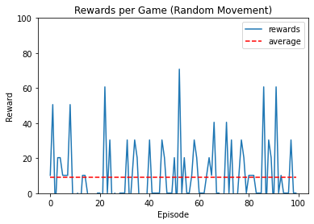
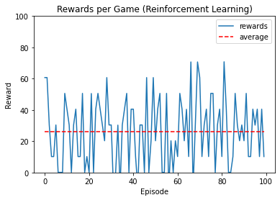
Additional results
Here are the results from a second pass. The RL model begins untrained and is not persisted. Again, the RL model outperforms random movement.
Notes:
Danny

Slide 30
Key Takeaways
Summary:
The Reinforcement Learning model performed better, with minimal training (100 games).
We would expect better performance (even a “solve”) by tuning the model design.
We didn’t tune number of layers, kernel size, gamma, epsilon, learning rate, momentum, etc…mostly due to performance reasons…but this surely affected performance.
Possible Objections:
How do we know it wasn’t by chance? (We’ve ran it multiple times)
Why didn’t you publish more results? (See next steps…mostly performance reasons)
I’m not convinced the RL model didn’t do better by chance. (the margins are small, but the RL model consistently outperforms random movement!)
Notes:
Danny

Slide 31
Lessons Learned & Next Steps
Lessons:
Reinforcement Learning is awesome!
We need better ways of visualizing the neural network (tools like TensorBoard).
We’ve only trained on 100 games. We need to train on more!
Next Steps:
Save the model for reuse so that we can eventually “solve” the game.
Tune the model design and parameters: learning rate, momentum, etc.
Experiment with other optimizer and loss algorithms.
Designing a more complex game in the future, implementing different game functionalities such as new map terrains and attack movements
Add in a crimson player (Go Cougs!) that moves randomly, and prove that the purple player performs better because it is smarter ;)
Notes:
Nick
Is awesome, with CNN and Q learning, there are a lot of applications outside of gaming.
We only trained for 100 episodes, looking forward, we will look to train on more games and
With the next steps, we will

Slide 32
Thank you!

Slide 33
Appendix

Slide 34
References
Kangle, S. (2021, June 1). Optimizers in Deep Learning - in short! (without maths). Medium. Retrieved March 16, 2022, from https://sanket-m-kangle.medium.com/optimizers-in-deep-learning-in-short-without-maths-98eb7c91e610
Lavanchy, M., & Joshi, A. (2021, September 28). An AI taught itself to play a video game – for the first time, it's beating humans. The Conversation. Retrieved March 14, 2022, from https://theconversation.com/an-ai-taught-itself-to-play-a-video-game-for-the-first-time-its-beating-humans-118028
Paszke, A. (2021). Reinforcement Learning (DQN) Tutorial. PyTorch. Retrieved March 13, 2022, from https://pytorch.org/tutorials/intermediate/reinforcement_q_learning.html
Torres, J. (2020, August 15). Deep-Q Network (DQN-II). Towards Data Science. Retrieved March 13, 2022, from https://towardsdatascience.com/deep-q-network-dqn-ii-b6bf911b6b2c
Trivedi, C. (2020, June 2). Game Level Design with Reinforcement Learning. Medium. Retrieved March 16, 2022, from https://towardsdatascience.com/game-level-design-with-reinforcement-learning-fa6eb585eb4e

